Slide 1

Financial Literacy: Empowering Economic Stability
Financial literacy means managing money wisely through budgeting, saving, and investing. It helps individuals make informed financial decisions and build economic independence.

Slide 2
Key Insights & Recommendations
Current Challenges
Effective Initiatives
Recommendations
Only 17% of adults in some developing countries are financially literate. Young and marginalized groups face higher risks.
Governments promote literacy via school programs, workshops, and online platforms.
Include financial literacy in school curriculums early on.
Use technology to reach underserved populations.
India’s RBI and SEBI run notable financial education campaigns.
Complex financial products and limited education access worsen inequality.
Partner with private sector to simplify financial products.

Slide 3
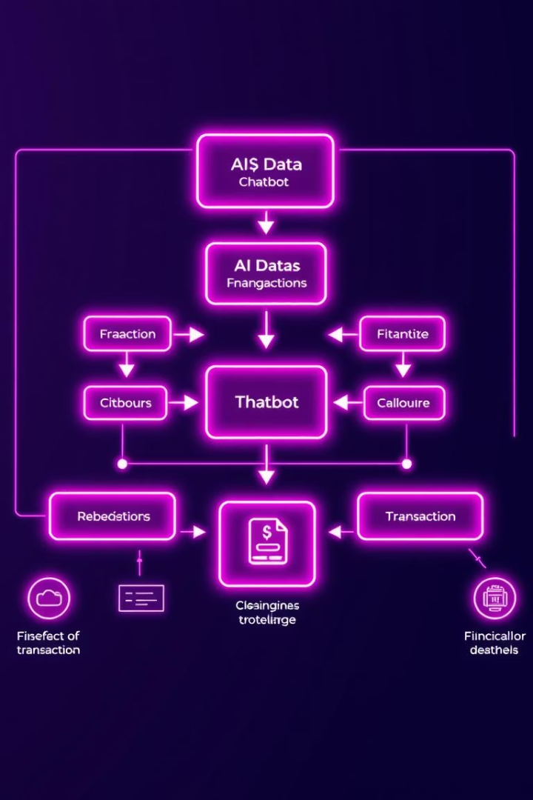

Financial Literacy AI Chatbot Architecture
This presentation explains the architecture and key components of a Financial Literacy AI chatbot built with Streamlit and Groq AI.
by Pruthviraj Patil

Slide 4
Environment Setup and Initialization
Environment Configuration
COM Initialization
AI Client Setup
Loads GROQ_API_KEY from .env for secure API access.
Initializes COM interface for Windows compatibility using pythoncom.CoInitialize().
Creates Groq client with API key for generating chatbot responses.

Slide 5
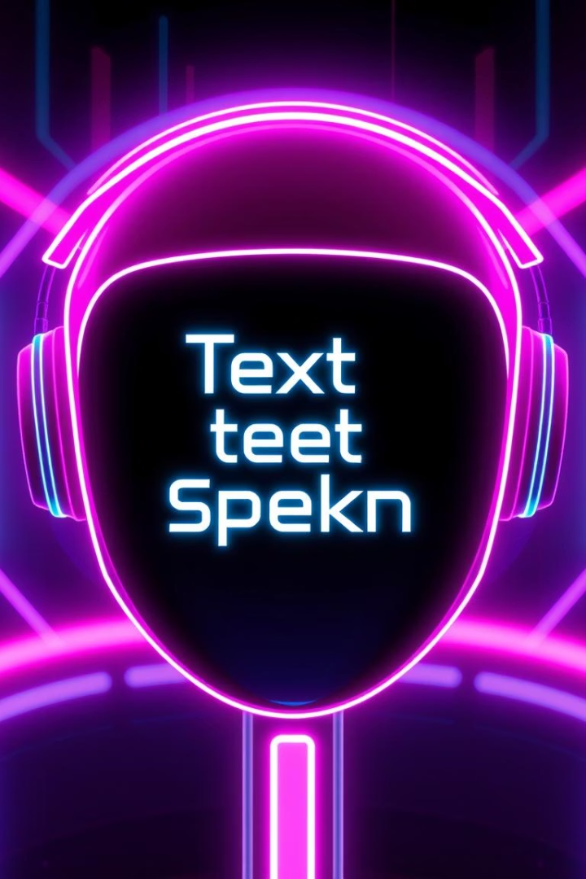
Speech Engine and Threading
pyttsx3 Engine
Asynchronous Speech
Initializes text-to-speech engine for audio responses.
Runs speech in a separate thread to avoid blocking UI.
Stop Speaking Control
Allows user to interrupt and stop speech playback.

Slide 6
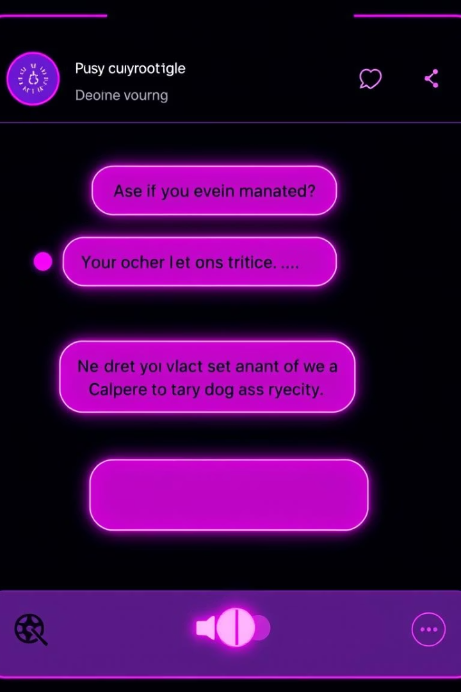
Session State and UI Controls
Session State Variables
User Interaction
Text input for questions
Messages: chat history log
Buttons for sending and clearing messages
Prompt: current input text
Voice Enabled: speech toggle
Toggle switch for voice mode
Chat Display
Renders conversation history dynamically with roles identified.

Slide 7
AI Response and Error Handling
Sending Queries
Voice Output
Error Management
Messages sent to Groq Llama3 model for completion generation.
Responses are optionally read aloud if voice mode is enabled.
Catches exceptions and shows error messages to users.

